Slide 1
IVR finals
Images and Capture
Image Segmentation
Description of Segments
Simple Object Recognition
Active Vision
Sensing and acting
Reference Frames
Inverse Kinematics
Dynamics
Control

Slide 2
Vision

Slide 3
Images and Capture – Vision Basics
Difficulties in computer vision
Viewpoint variation
Illumination
Scale
Non-rigid deformation (same object in different positions)
Occlusion (partially/fully hidden)
Background clutter
Intra-class variation of objects (eg different types of chairs)
Inherent ambiguity (eg illusions)
Some basic physics/facts
Human colour perception
400 – 700 nm
Three kinds of cones in the eye (RGB)
More long and medium wave sensors – more perceptive of red and green
Human eye is more sensitive to green light than red or blue
Light depends on
The light source: shape, position, colour
The scene: shapes, surfaces, shadows, object colour, etc
Sensor properties: camera properties, filters, etc
How imaging sensors/cameras work
Each pixel of the camera captures photons
Photons are converted to electrons, which are then shifted along the row and “collected” to be digitised
Color spaces
RGB
Linearly combined to produce all colours
Good for computers but unnatural for humans
HSV
Hue: Colour
Saturation: Paleness
Value: Intensity/brightness
Aperture size
Varies the amount of light captured on the film

Slide 4
Images and Capture – Difficulties of Image Capture
Depth of field
Different levels of focus for different depths
Can use a smaller aperture to increase depth of focus; reduces the amount of light receives so need to compensate by using brighter light
Shadows & non-uniform illumination
Increase ambient lighting using light diffusing panels, or many point lights
Place illumination near the camera
Specularities/highlights
Light reflecting off the object, straight into the camera
Increase ambient lighting using light diffusing panels
Motion blur
Use a shorter capture time (and brighter light to compensate)
Saturation problems
Use a smaller aperture to reduce light, or reduce the gain
Radial lens distortion
Straight lines captured as bent
Use a more expensive lens, or view from a further distance
Aliasing
Flickering lights at a certain frequency might cause bright and dark images
Use incandescent light instead of fluorescent light

Slide 5
Image and Capture – Projection
Projecting from 3D to image plane (2D)
Not preserved
Distance, angles and lengths
Preserved
Straight lines, incidence (intersecting lines)
Properties of projection
Many-to-one mapping
All points along the same ray of light map to the same point in the image (lost of info)
Lines to lines
Collinearity is preserved: things in a line remain as seen in a line
Except for the line going through the focal point, maps to a single point
Planes to planes
All planes in 3D map to a plane in the image
Except for the plane through the focal point, maps to a line
Vanishing points
All directions in 3D has a vanishing point in the image, where all lines in 3D in that direction converge at a point in 2D
Except for the direction parallel to the image plane

Slide 6

Image and Capture – Projection
Homogenous coordinates
Homegenous image coordinates: $\left(x,y\right)⇒\left(\begin{matrix}x \\ y \\ 1\end{matrix}\right), \left(\begin{matrix}x \\ y \\ w\end{matrix}\right)⇒\left(\frac{x}{w},\frac{y}{w},\frac{z}{w}\right)$
Similar for homogenous scene coordinates (x,y,z)
Projection matrix
P = $\left[\begin{matrix}1 & 0 & 0 & 0 \\ 0 & 1 & 0 & 0 \\ 0 & 0 & 1/f & 0\end{matrix}\right]$
To get image coordinates:
$P×\left(\begin{matrix}x_{s} \\ y_{s} \\ z_{s} \\ 1\end{matrix}\right)=\left(\begin{matrix}x_{1} \\ y_{1} \\ w\end{matrix}\right)$
$\left(x_{i}, y_{i}\right)=\left(\frac{x_{1}}{w} ,\frac{y_{1}}{w}\right)$
Homography
A projection that maps points from one plane to another
Accounts for 8 degrees of freedom
Homography projection matrix
Requires at least 4 matched points between the 2 planes
Can be estimated using direct linear transform method
Find least square estimate of P that satisfies the 4 equations

Slide 7
Image Segmentation – Mean-Shift Clustering
Some common methods of region segmentation
Contrast (light thresholding)
Change: knowing the background, find the changes to identify the objects
Similarity: grouping pixels by similar properties, eg colour clustering
Mean-shift clustering
Mode: local maximum in a distribution
Find the modes in a histogram using iterative mode search
With a random seed and a window size W, calculate the center of gravity/”mean” of W
Shift the search window to the mean
Repeat this until mean converges
Do a mean-shift at every data point, and find the attraction basin(s)
Attraction basin: the region on the image where all trajectories point to the same mode
Merge all the windows in that attraction basin (eg give them all the mean colour)
Pros
Easy to apply, model-free, only one parameter (W), robust to outliers
Cons
Dependent on W, which is not easy to choose
Computationally expensive
Does not scale well with dimension of feature space (eg mean-shift clustering with 2 features)

Slide 8
Image Segmentation – Thresholding
Assuming pixel values are separable
Choose a threshold value that isolates dark and light peaks in the image histogram
Assuming 2 big peaks
Find the lowest point in the trough between the 2 peaks
Smoothing the histogram - convolution
To better identify the peaks in the histogram
Computed using a weighted sum of image data and a fixed mask
1D and 2D convolution
Also useful for edge detection, noise removal, etc

Slide 9

Image Segmentation – Background Removal
Removing the background to find the change in image
Assuming camera is in a fixed position, before/after photos
Threshold the change in pixel value between the 2 images
Can use on individual RGB channels
Find the introduced object by OR-ing the threshold on the 3 channels
To account for varying lighting/shadows, use normalised RGB representation
$\left(r,g,b\right)→\left(\frac{r}{r+g+b},\frac{g}{r+g+b},\frac{b}{r+g+b}\right)$
Background ratio isolation
To deal with varying illumination
Divide after image by before image
If above or below a certain threshold, it is the object
Note
Darker = lower value, lighter = higher value

Slide 10
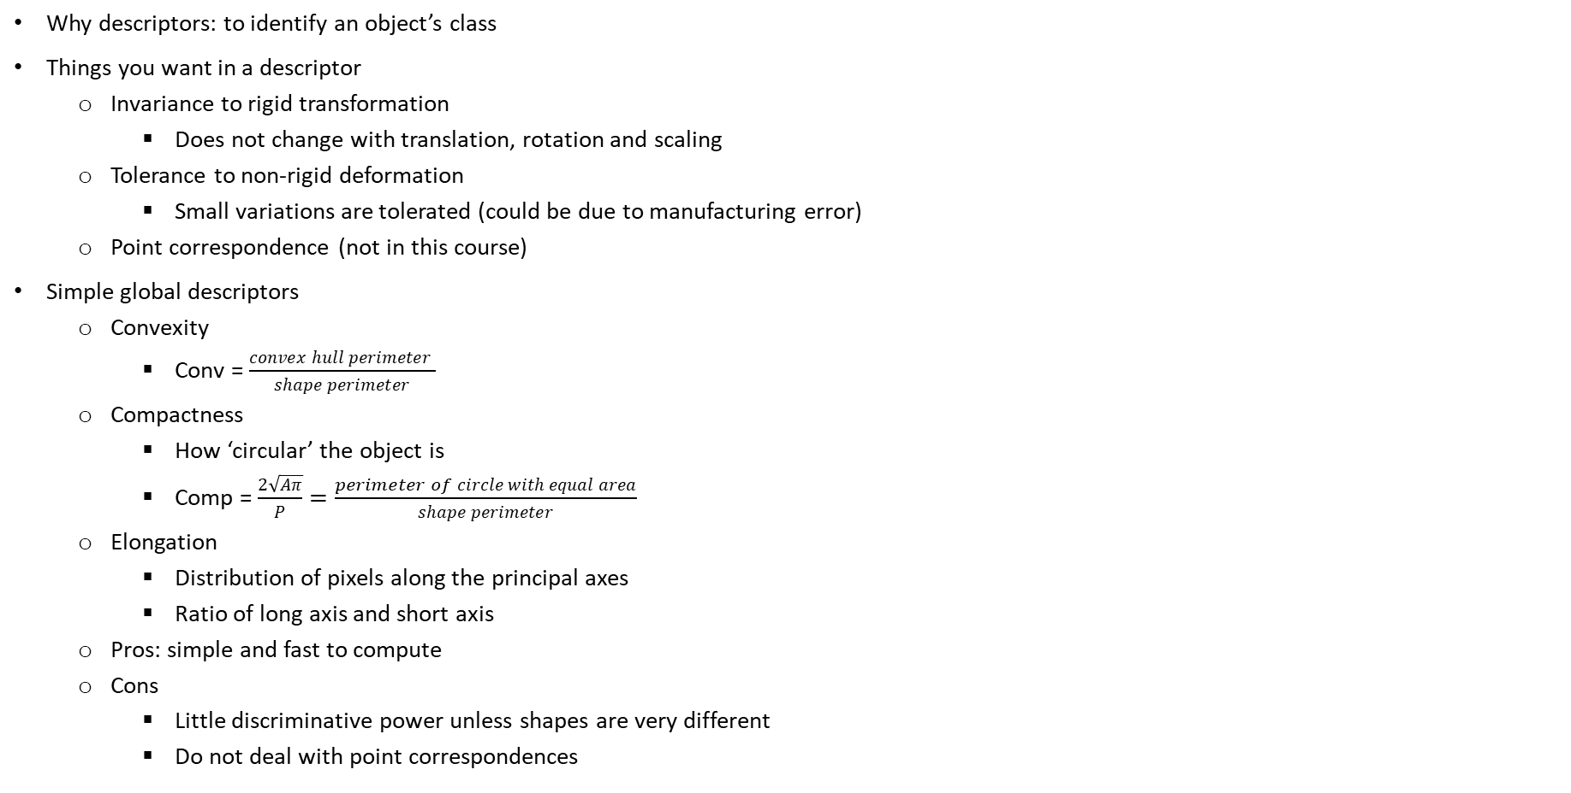
Description of Segments – Simple Global Descriptors
Why descriptors: to identify an object’s class
Things you want in a descriptor
Invariance to rigid transformation
Does not change with translation, rotation and scaling
Tolerance to non-rigid deformation
Small variations are tolerated (could be due to manufacturing error)
Point correspondence (not in this course)
Simple global descriptors
Convexity
Conv = $\frac{convex hull perimeter }{shape perimeter}$
Compactness
How ‘circular’ the object is
Comp = $\frac{2\sqrt{Aπ}}{P}=\frac{perimeter of circle with equal area}{shape perimeter}$
Elongation
Distribution of pixels along the principal axes
Ratio of long axis and short axis
Pros: simple and fast to compute
Cons
Little discriminative power unless shapes are very different
Do not deal with point correspondences
convex hull perimeter
shape perimeter

Slide 11
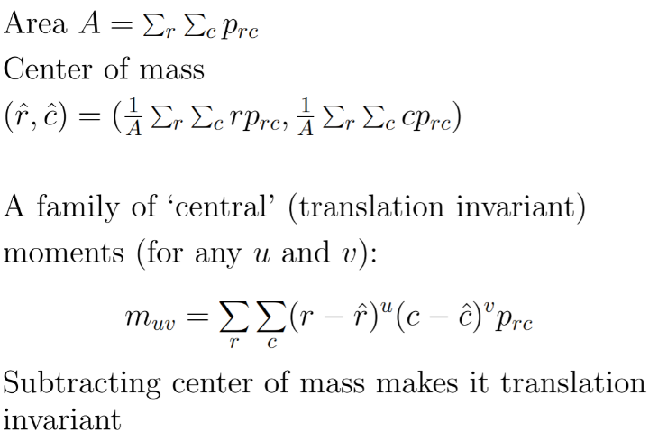
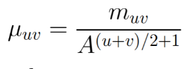
Description of Segments – Moments as Descriptor
Moments: An infinite family of numerical shape descriptors
Can be made invariant to rigid transformations (trans/rot/scal)
Steps
Calculate the area and center of mass of the image
Get the first, ‘central’ moment
Can use ANY u, v – infinite family
Invariant to translations because taking the difference between center of mass position and the point position
Make it scale invariant
Make it rotation invariant
Use a different formula for central momen (complex numbers)
Make it scale invariant
Calculate complex invariant moments
Feature vector
Pack all the descriptors into a single vector to describe a single shape

Slide 12
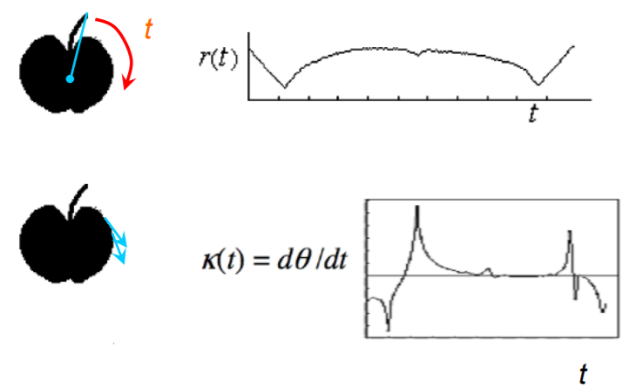
Description of Segments – Shape Signatures
Describing the boundary of a shape using a 1D function (a graph)
Centroid distance
Distance from center of shape to the boundary
Curvature
How curved each point is along the boundary
Can also use area, angles, etc
Pros
Invariant to rigid deformation (if shape is normalised beforehand)
Point correspondence
Handles shape deformations to some degree
Quite informative
Cons
Sensitive to noise (especially for derivatives)
High matching cost – where on the graph do you start?
Shape contexts
Looks more at individual points and its neighbourhoods, match the most similar neighbourhoods between 2 objects
Informative, invariant to translation, allows for some shape deformaties
Invariant to scale if shape is normalised
However, not invariant to rotation, computationally expensive, and requires many parameters

Slide 13
Object Recognition – Intro
5 classes of object recognition algorithms
Shape (similar shape descriptors)
Appearance (similar pixel values)
Geometric
Graph
Bag of words (similar local feature descriptors)
High-level shape-based recognition algorithm
Extract object from image
Compute properties
Use properties to compute class
Learning model’s properties for the class

Slide 14
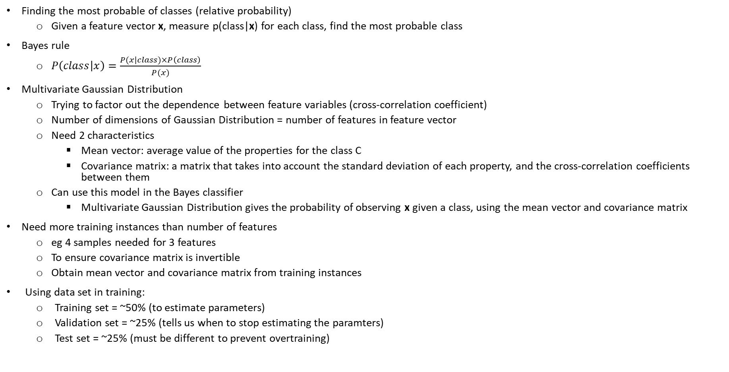
Object Recognition – Probability & Bayes Classifier
Finding the most probable of classes (relative probability)
Given a feature vector x, measure p(class|x) for each class, find the most probable class
Bayes rule
$P\left(class | x\right)=\frac{P(x|class)×P\left(class\right)}{P(x)}$
Multivariate Gaussian Distribution
Trying to factor out the dependence between feature variables (cross-correlation coefficient)
Number of dimensions of Gaussian Distribution = number of features in feature vector
Need 2 characteristics
Mean vector: average value of the properties for the class C
Covariance matrix: a matrix that takes into account the standard deviation of each property, and the cross-correlation coefficients between them
Can use this model in the Bayes classifier
Multivariate Gaussian Distribution gives the probability of observing x given a class, using the mean vector and covariance matrix
Need more training instances than number of features
eg 4 samples needed for 3 features
To ensure covariance matrix is invertible
Obtain mean vector and covariance matrix from training instances
Using data set in training:
Training set = ~50% (to estimate parameters)
Validation set = ~25% (tells us when to stop estimating the paramters)
Test set = ~25% (must be different to prevent overtraining)

Slide 15
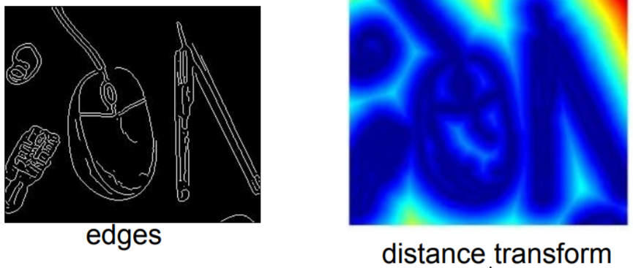
Object Recognition – Chamfer Matching
Matching and finding positions of objects with an error score
Edges/boundaries must have been found in the image already (use an edge image)
Ignores colour, lighting etc
Chamfer distance = average distance to the nearest edgel
Edgel: a pixel in an image recognised as the edge of something
Slide template over edge image and find the chamfer distance at each point
Distance transform
Lookup table: shows the distance of each pixel to the nearest edgel
Computing the distance transform is O(num of pixels)
Slide template over distance transform instead of edge image
Pros
Copes with cluttered images
Can deal with small changes in scale, small amounts of deformation
Works with fragmented edges
Simple, fast
Cons
Many false positive in cluttered regions
Not smart matching
Each different shape (variants or deformaties) needs a different mask, adds to computational complexity

Slide 16
Active Vision
A sequence of images, like a video stream
More information can be obtained more easily, such as depth, structure, location of object
Pros of active vision
Obtain information such as depth, location, structure
Can identify main object by comparing different images
Can see object movement, analyse motion response of objects
Can focus computer’s processing power on the main subject
Human vision
Center of attention has highest resolution area
If computer knows where center of attention is, can focus on that area, create impression of a complete, detailed scene
Attention is drawn toward several image properties
Orientation, size, colour
Focus more on properties that are “salient” – noticeable
Attention is drawn to motion
Attention is given based on task
Motion can help reconstruct 3D object
Parallax: displacement in apparent position of object when viewed from two different lines of sight
Closer objects change apparent position more when we move

Slide 17
Robotics
Sensing and acting
Reference Frames
Inverse Kinematics
Dynamics
Control
ROS basics

Slide 18
Components of robots
Sensory components
Acquiring information
Actuatory and effectory components
Realising actions and behaviours
Information processing and control
Processing signals, memory, planning and evaluation
Open loop: no feedback
Closed loop: feedback, maybe with touch or vision
Plus
Batteries, interfaces, communication, etc

Slide 19
Robotic Sensors & Actuators
Robotic Sensors
Purpose: location, objects and obstacles
Capabilities of sensors
Distance sensing (vision, sound, smell)
Contact sensing (taste, pressure, temperature)
Internal sensing (balance, position, damage)
Classifying sensors
Exteroceptive sensors
Perceiving external objects; distance and contact
Proprioceptive sensors
Perceiving self movement and internal states
Exproprioceptive sensors – combination
Alternative classification
Active: emits energy (eg radar)
Passive: receives energy (eg camera)

Slide 20
Robotic Sensors & Actuators
Underactuated robot
If DOF < number of joint parameters
Can disregard some position parameters
Overactuated/redundant robot
If DOF > parameters
Will have more than 1 solution
Robotic Actuators
Effector
Any device that has an impact on the environment (eg wheels, legs, grippers)
Actuator
A mechanism that enables effectors to execute actions (eg motors)
Joints
Rotary (rotation) or prismatic (linear motion)
Degrees of freedom
Number of directions in which independent motion can occur (translation and rotation)
Independent parameters that define the configuration of a robot
2D: 3DOF (2 trans, 1 rot)
3D: 6 DOF (3 trans, 3 rot)
Degrees of freedom of real world objects
A rigid body (bodies in 3D) requires 6 DOF: 3 for position, 3 for orientation
Human arm has 7 or 8 DOF
Having more DOF than required makes it a redundant manipulator
However, redundancy is useful for accommodating extra constraints, or doing tasks in a more optimal manner
Considerations when choosing actuators
Load it can bear
Speed, resolution (how specific)
Accuracy, repeatability, reliability
Power consumption, weight

Slide 21
Task Space, Configuration Space, Reference Frames
Workspace aka task space
Space of all possible positions the robot arm can move to
Configuration space
Vector of all possible joint positions
Vector space dimension = joint’s DOF
The kinematic model maps configuration space to task space
Reference Frames
A frame defined by 3 orthogonal unit vectors (axes)
Necessary to be established – inertial frame
So that Newton’s Laws will take effect
Can calculate position and orientation
Rotation matrix represents orientation of each new axes on the original axes
Always use right-hand coordinate system to define new coordinate system

Slide 22
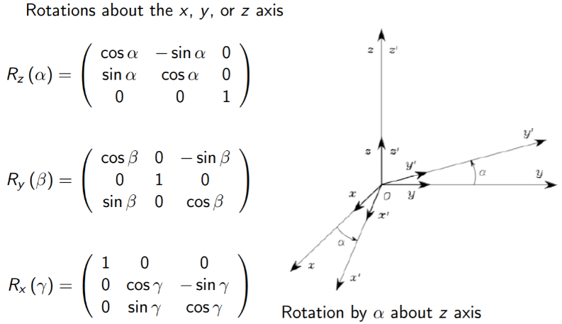
Rotation Matrices
Rotation can be parametrised by 3 angles
For each rotation about the x, y or z axis, will have an elementary matrix
Multiply elementary matrices for a combination of rotations
Properties of all rotation matrices
R^{T} = R⁻¹
Useful for transforming coordinates back and forth frames
^{A}v = (R^{A}_{B} )(^{B}v)
R^{-1 A}_{B} (^{A}v) = R^{T} (^{A}v) = ^{B}v
det(R) = |R| = 1
Rotation does not scale the vector
3 geometric meanings of the rotation matrix R^{A}_{B}
Coordinate transformation from frame A to B (transform coordinates)
An operation to rotate a vector (rotate vectors)
Defines the three coordinate vectors of frame A with respect to frame B (define axes)
Euler angles
Pick 3 angles (eg ZYZ, or roll-pitch-yaw), used to represent rotation to any orientation
Can calculate rotation matrix from Euler angles, or Euler angles from rotation matrix
Except in Gimbal Lock situation
When you cannot get 3 angles from a 9-element matrix
Happens when the second rotation angle (for ZYZ convention) is 0 or a multiple of pi
1st and 3rd angle become coupled – cannot be uniquely determined/ lose one DOF

Slide 23


Homogenous Transformations
Combining rotation and translation
Distance moved given by $o_{1}^{0}$, rotation matrix given by R_{3x3},
$\left(\begin{matrix}p^{0} \\ 1\end{matrix}\right)=\left(\begin{matrix}R_{3x3} & o_{1}^{0} \\ 0_{3x1} & 1\end{matrix}\right)\left(\begin{matrix}p^{1} \\ 1\end{matrix}\right)$
For the coordinates p⁰ to p¹
Combining transformations
Can find the position and orientation of the robot in its task space as a function of its joint angles
$x_{e}=k\left(q\right)$, where x_{e} = end effector position, q = vector of joint variables
Denavit-Hartenberg Convention (D-H)
A convention for defining reference frames
Using only 4 parameters, can model robots and their transformation matrices in the simples possible way

Slide 24
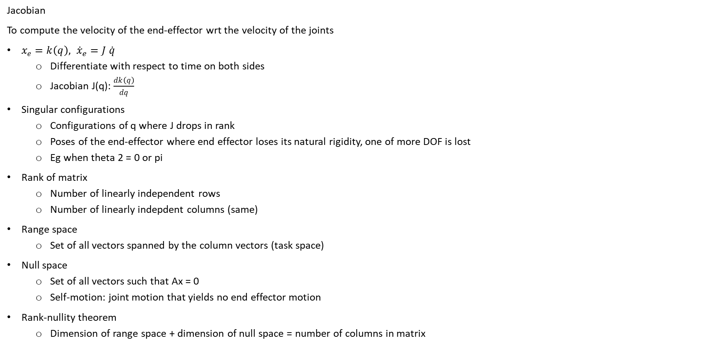
Jacobian Matrix & Inverse Kinematics
Jacobian
To compute the velocity of the end-effector wrt the velocity of the joints
$x_{e}=k\left(q\right), {\dot{x}}_{e}=J \dot{q}$
Differentiate with respect to time on both sides
Jacobian J(q): $\frac{dk\left(q\right)}{dq}$
Singular configurations
Configurations of q where J drops in rank
Poses of the end-effector where end effector loses its natural rigidity, one of more DOF is lost
Eg when theta 2 = 0 or pi
Rank of matrix
Number of linearly independent rows
Number of linearly indepdent columns (same)
Range space
Set of all vectors spanned by the column vectors (task space)
Null space
Set of all vectors such that Ax = 0
Self-motion: joint motion that yields no end effector motion
Rank-nullity theorem
Dimension of range space + dimension of null space = number of columns in matrix

Slide 25

Jacobian Matrix & Inverse Kinematics
Inverse Kinematics
To find q, knowing x_{e}
${\dot{x}}_{e}=J \dot{q}$
$q= \int{J^{−1}}{\dot{x}}_{e}+q_{0}$
However, problem if J⁻¹ is not invertible
Dealing with overactuated robots
Can optimise other things like kinetic energy of the robot
Can also have robot meet secondary objectives like posture, work around an object
Dealing with non invertible J
Pseudo-inverse $\dot{q}=J^{+}\dot{x}$
Least squares solution: $J^{+}={\left(J^{T}J\right)}^{−1}J^{T}$
‘Left hand pseudo inverse’
Lagrange multipliers: $J^{+}=J^{T}{\left({J J}^{T}\right)}^{−1}$
‘Right hand pseudo inverse’
Dealing with singularities
Try to stay away from singularities
Use damped least squares
Use Jacobian transpose

Slide 26

Static Equilibrium
Virtual work done
Virtual work done by robot joints during an infinitesimal displacement
$τ^{T}△q$
Virtual work done by external force at end effector during that displacement
$F^{T}△x$
For static equilibrium, both have to be equal
Therefore,
$τ=J^{T}F$
Joint torque = Jacobian^{T} x end-effector force

Slide 27
Dynamics
Forward dynamics
How the robot accelerates given applied forces and its state
Calculate movement from force
Useful for simulation and prediction
Inverse dynamics
How much force we need to apply to generate a certain desired motion
Calculate force from movement
Useful for control

Slide 28
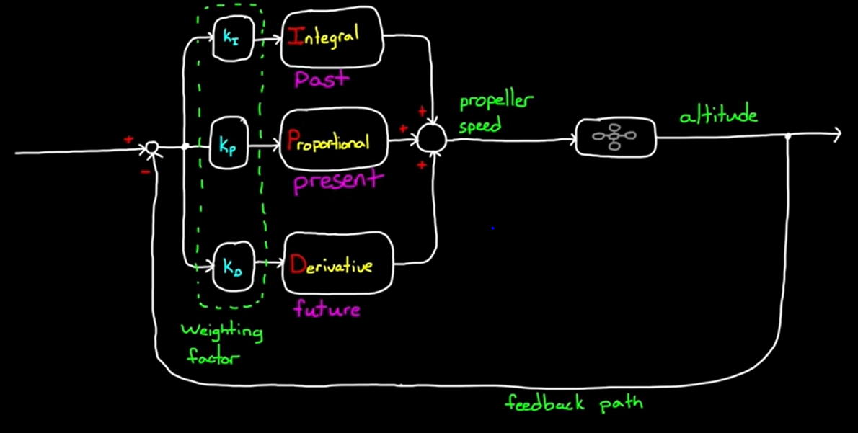
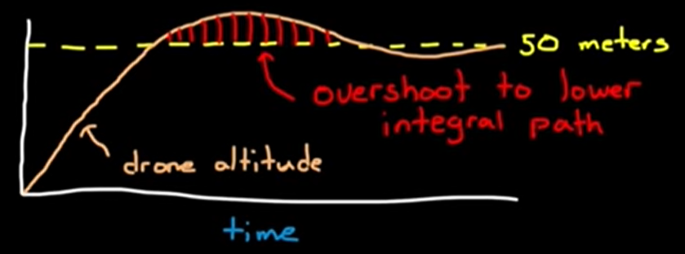
PID Controller
A controller that generates input, to get an output
Error
The difference between the output of the system and the desired value
Steady state error
Where the error converges to, never reaches 0
Normally occurs when the system needs a non-negative input for 0 error
Proportional (P)
Present
Using the error term to generate input with some gain/proportion (eg 5*error)
Integrator (I)
Past
Keeps a running total of the error over time
To deal with steady state error – when total increases when there is steady state error, increases input such that error is driven down
Derivative (D)
Future
Measures the rate of change of error
Prematurely decreases input if the error is rapidly changing so as to not overshoot the goal
Each branch (PID) has it’s own gain factor

Slide 29
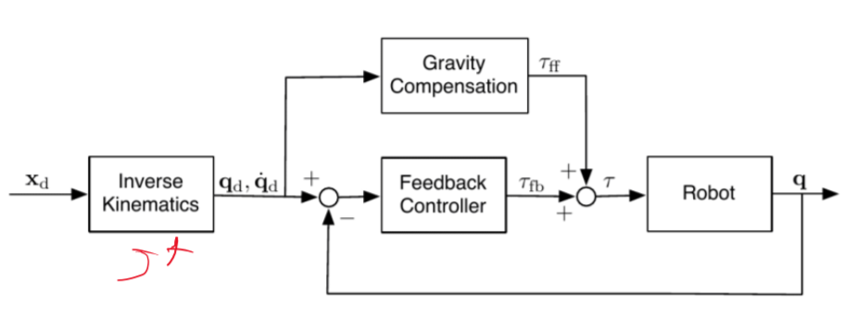
PID Controller – Choosing I
Is integral control useful or necessary?
Not safe
Wind-up effects
Initial phase can lead to large values that result in unpredictable behaviour
Any errors after the initial phase will be compensated
Small gain factor usually used for precision
This means a long reaction time, and therefore not good for tracking tasks
Not necessary
Only needed if steady state error is expected, or if system is noisy
To mitigate these effects
Reset integral
Imperfect or time-windowed integration
Disable the integral function until a certain region of error
Initialise the integral at a suitable value
Another way to reduce steady state error
Using a model to model gravity/etc (adding a constant instead of scaled term)

Slide 30
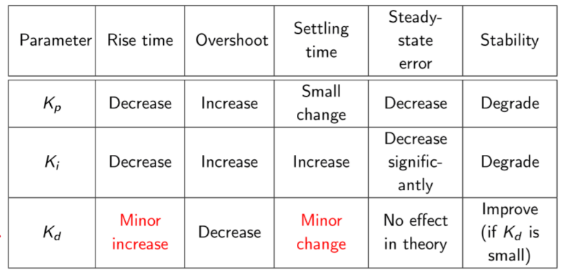
PID Controller – K Characteristics
Effect of increasing K:
Characterising a control system
Stability
Returning to the same point if there are small unintentional motions
Accuracy
The difference between steady-state output and desired output
Settling time
Time needed to converge to steady state
Rising time
Time for the plant output to rise beyond 90% of the desired level for the first time
Overshoot
How much higher the peak level is than steady state, normalised against steady state
Choosing gain factors
Low gain – less energy used for control, precision
High gain – faster response
Typically
Kp to decrease rise time
Ki to eliminate steady state error
Kd to reduce overshoot and settling time

Slide 31
PID Control – Limitations
Needs errors (an optimal value) to be able to react
Is only reactive and may be slow
D and I may suffer from sudden changes
D may suffer from intrinsic noise
Use a low-pass filter
Is linear, not symmetric
Cannot work both ways – eg increasing and decreasing the height of a propeller
Gain is tuned specifically to a systeme, unique to a system

Slide 32
ROS
Robotic operating system: An OS that allows one to simulate and run robots in (soft) real-time
Open-source and light-weight
Simulators like Gazebo obey the laws of physics
Allows for message passing
Communication in ROS
Subscriber-publisher
Node and topic
Many to many
Service-client
One to one
Master node
Manages the communication between nodes
All nodes register at start up with the master
Started with ‘roscore’
Node
A piece of executable code
All nodes communicate with the master node
Topic
Nodes communicate over topics
Each node can publish or subscribe to a topic
Service
Services allow nodes to send a request and receive a response
One time request: service node runs once then finishes
Messages
Data that is published to a topic, that is ordered in a certain way
User interface rqt
RQT – for GUI development in ROS, can be used to plot data, view images, node graphs, etc

